Slide 1

Xelerate Product
Project Guide: Dr.Fousia Shamsudheen
Presented By: Ajmi A (TKM18MCA005)

Slide 2
Overview
Introduction
01
02
Product Versions
Why Xelerate?
03
04
Xelerate Benefits to Clients
Xelerate Key Product Modules
05
06
Current Status

Slide 3

Introduction
Xelerate is the technology platform of SunTec Business Solution.
Xelerate is a Revenue Management and Business Assurance System.
It is a web application developed mainly using Java and Oracle.
The products are build on top of Xelerate platform.

Slide 4
Product Versions
* TBMS – Telecom Billing Management System
TBMS * 1.x
TBMS 2.x
TBMS * 3.x
TBMS 4.x
TBMS 5.x
Xelerate 1.x
* TBMS – Transaction Business Management System

Slide 5
WHY XELERATE ?
To make the product in such a way that functionality/ feature wise selling is possible.
To incorporate new banking trends that helps service providers to create real-time personalized offerings to customers
To bring Xelerate as a front end system of the service provider where product managers/ relationship managers can rollout new offerings and attract customers
To bring a true productized approach internally

Slide 6
Xelerate – Benefits to Clients
A
Enabling the creation of highly flexible and trusted Personalized Product Offerings
Enabling the creation and proactive management of Customer Experience
Enabling high volume data driven decision making to achieve Business Assurance
B
Enabling comprehensive Revenue Management through flexible pricing and settlement structures

Slide 7
Xelerate Key Product Modules
Security and Administration
Product Catalogue
Customer and Account Management
Loyalty
Xelerate suite of products
Offer Management
Interfaces
Pricing
Invoicing and Payment Management

Slide 8
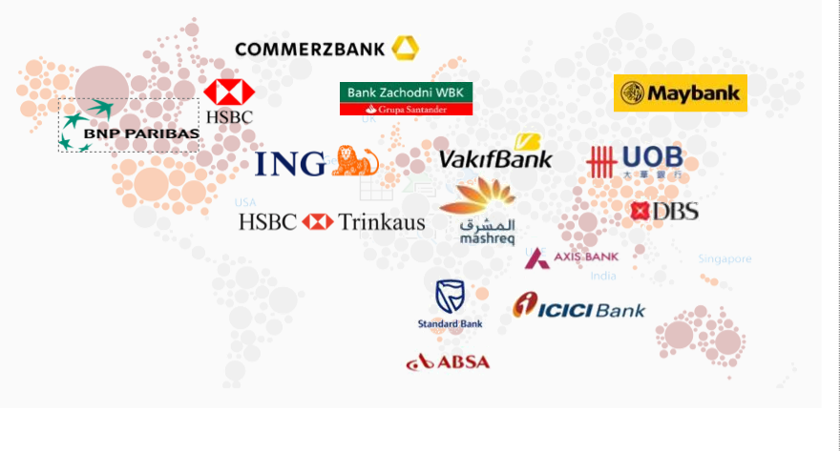
SunTec offers solutions to leading institutions globally
Designer
Programmer
Text Here
Text Here

Slide 9
Hardware Specifications
Windows 7, Linux
12GB RAM
15GB Storage
Software Specifications
Java
Oracle SQL Developer

Slide 10
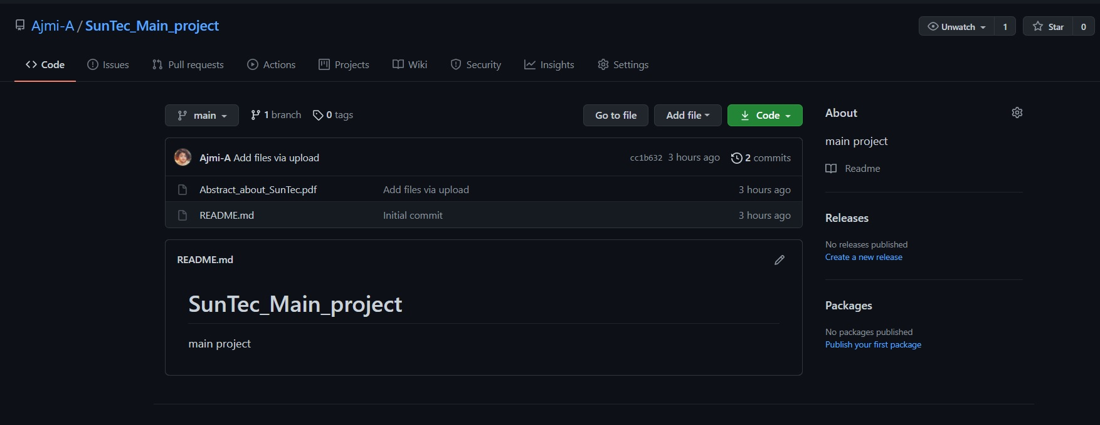
Screenshot – Git Repository

Slide 11
Current Status
Completed the X2.6 training and Certification.
Currently doing project with ICICI project team.

Slide 12

ICICIDemandDraft
PayOrderCharging
FundT
ransferCharging
V
alueAddedServices
CashT
ransactionProcessing
ChequeProductProcessing
IciciDebitCardBPW
rapper
GenSetUniqueKey
GenResolveService
IciciCashDenomination
ConsT
ransactionCharging
IciciCAMMediationBP
GroupFreelimitMetadataLoading
CashDenominationPricing
CashDepositLoadProcess
MinMaxChrgPricing

Slide 13
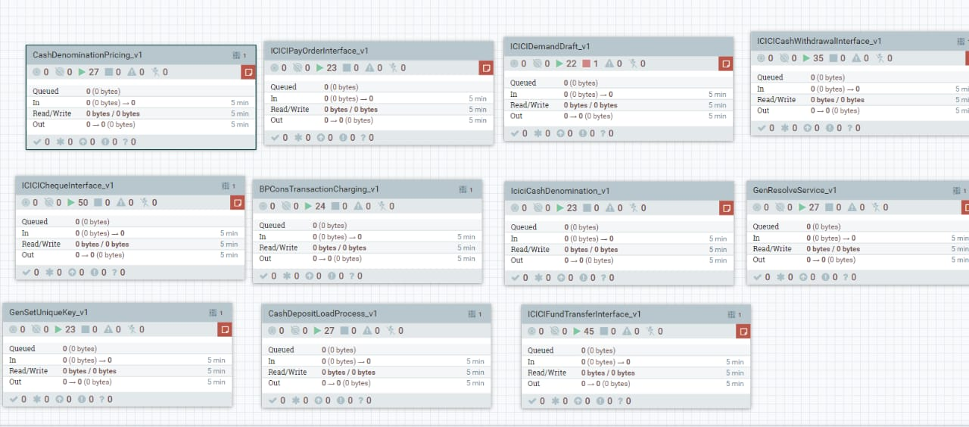
Screenshot -Deployed Interfaces
Designer
Programmer
Text Here
Text Here

Slide 14
Work Flow of Demand Draft Transaction
priced_transaction_data
businesstransaction
DD Input file
ICICIDemandDraft
demanddraft
Consolidation
consbusinesstransaction
Required?
-
DA51_862
demanddraft

Slide 15
Work Flow of PayOrder charging Transaction
priced_transaction_data
businesstransaction
PO Input file
PayOrderCharging
payorder
Consolidation
consbusinesstransaction
-
Required?
-
DA51_862
payorder

Slide 16
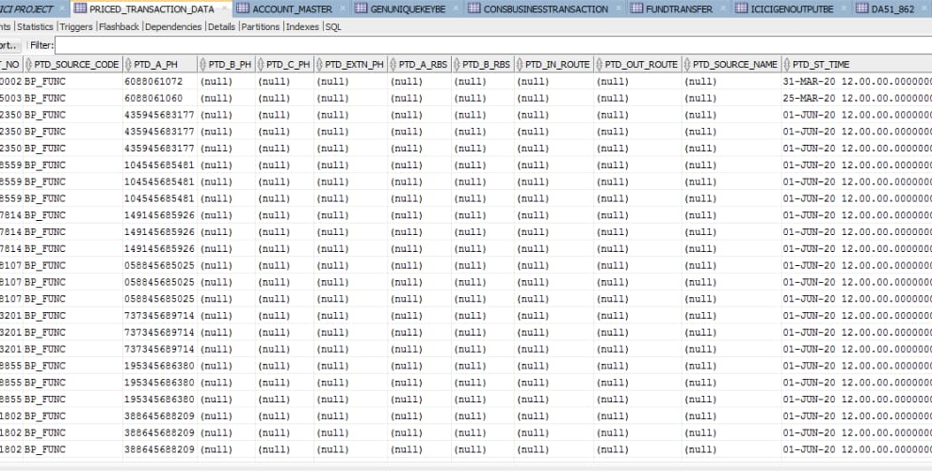
Screenshot-DataBase
Designer
Programmer
Text Here
Text Here

Slide 17
THANK YOU

